Slide 1
Regularizing Face Verification Nets To Discrete-Valued Pain Regression
Feng Wang, Xiang Xiang, Chang Liu, Trac D. Tran, Austin Reiter, Gregory D. Hager, Harry Quon, Jian Cheng, Alan L. Yuille
Johns Hopkins University & University of Electronic Science and Technology of China

Slide 2
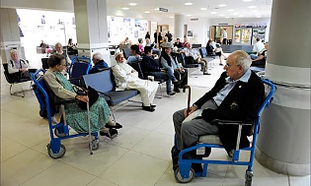
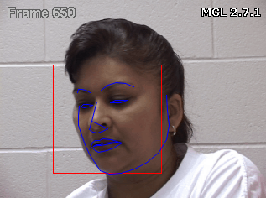
Monitoring pain through cameras
Patients are typically not monitored in the waiting room.
- Deteriorations happen unnoticed. Pain is a sign of deterioration.
e.g., In US 1.3 million deteriorations in waiting rooms per year.
1. It simplifies pain reporting process; reduce the strain on manual efforts.
2. It standardizes the feedback mechanism by ensuring a single automated metric that performs all assessments and thus reduces bias

Slide 3
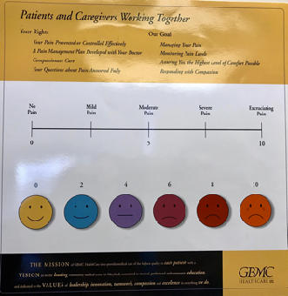
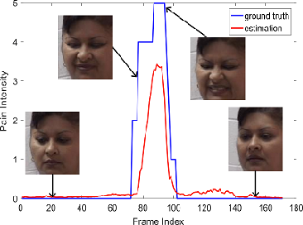
Limited data with labeled pain intensities
1. It needs expertise to label the pain and per frame labeling is tedious.
2. Easily overfitting small dataset and not generalizing well to real data.
3. Label is discrete and majority is 0.

Slide 4
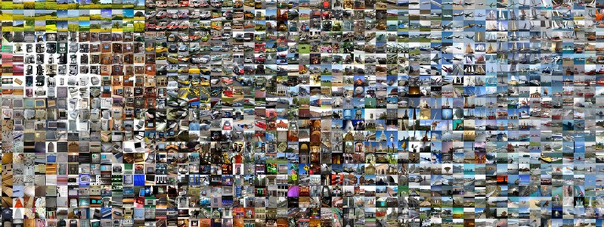
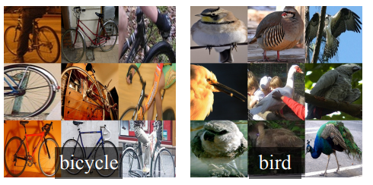
CNNs need large dataset
CNNs have incredible power of image representation.
CNNs need lots of data to train the huge number of parameters.
Transfer learning is a good technique for small datasets, e.g. ImageNet (1M)->PASCAL VOC (10K) for image detection.
transfer
Yosinski J, Clune J, Bengio Y, et al. How transferable are features in deep neural networks? NIPS 2014
Girshick R, Donahue J, Darrell T, et al. Rich feature hierarchies for accurate object detection and semantic segmentation. CVPR 2014

Slide 5
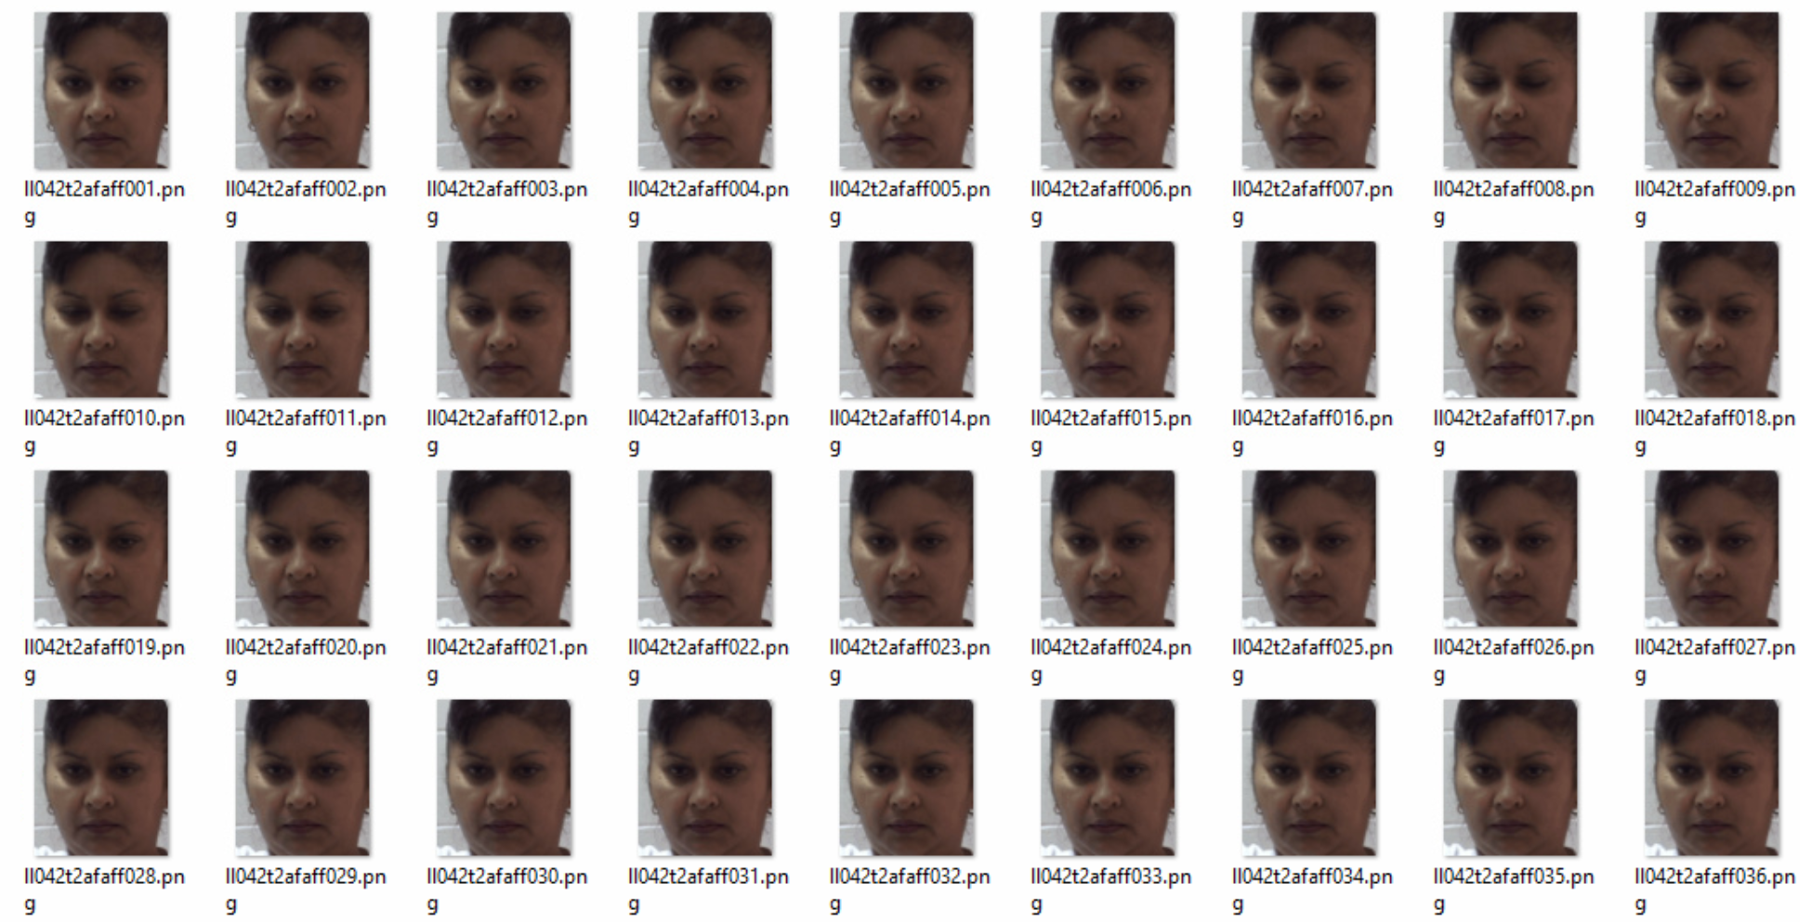
Datasets for Pain Regression is small
UNBC Shoulder-Pain: 200 videos, each has ~200 frames.
Video frames are redundant.

Slide 6
Datasets for Face Recognition is big
CASIA-Webface: 10k identities, 0.5M images.
VGG Face: 2,622 identities, 2.6M images.
MS-Celeb-1M: 1M identities, 8M images.
Available for Deeper CNNs
In this work, we use a 28 layer ResNet.
Wen Y, Zhang K, Li Z, et al. A discriminative feature learning approach for deep face recognition. ECCV 2016

Slide 7
Transfer from Face Recognition Net to Pain Regression Net
Original model: a 28-layer ResNet,
trained on 0.5M images with identity labels,
with recognition loss, regularized by center loss,
get ~99% on LFW 6,000 pairs protocol.
Transfer to: UNBC Shoulder-Pain Dataset,
trained on 10K images with pain level labels,
with regression loss regularized by center loss.

Slide 8
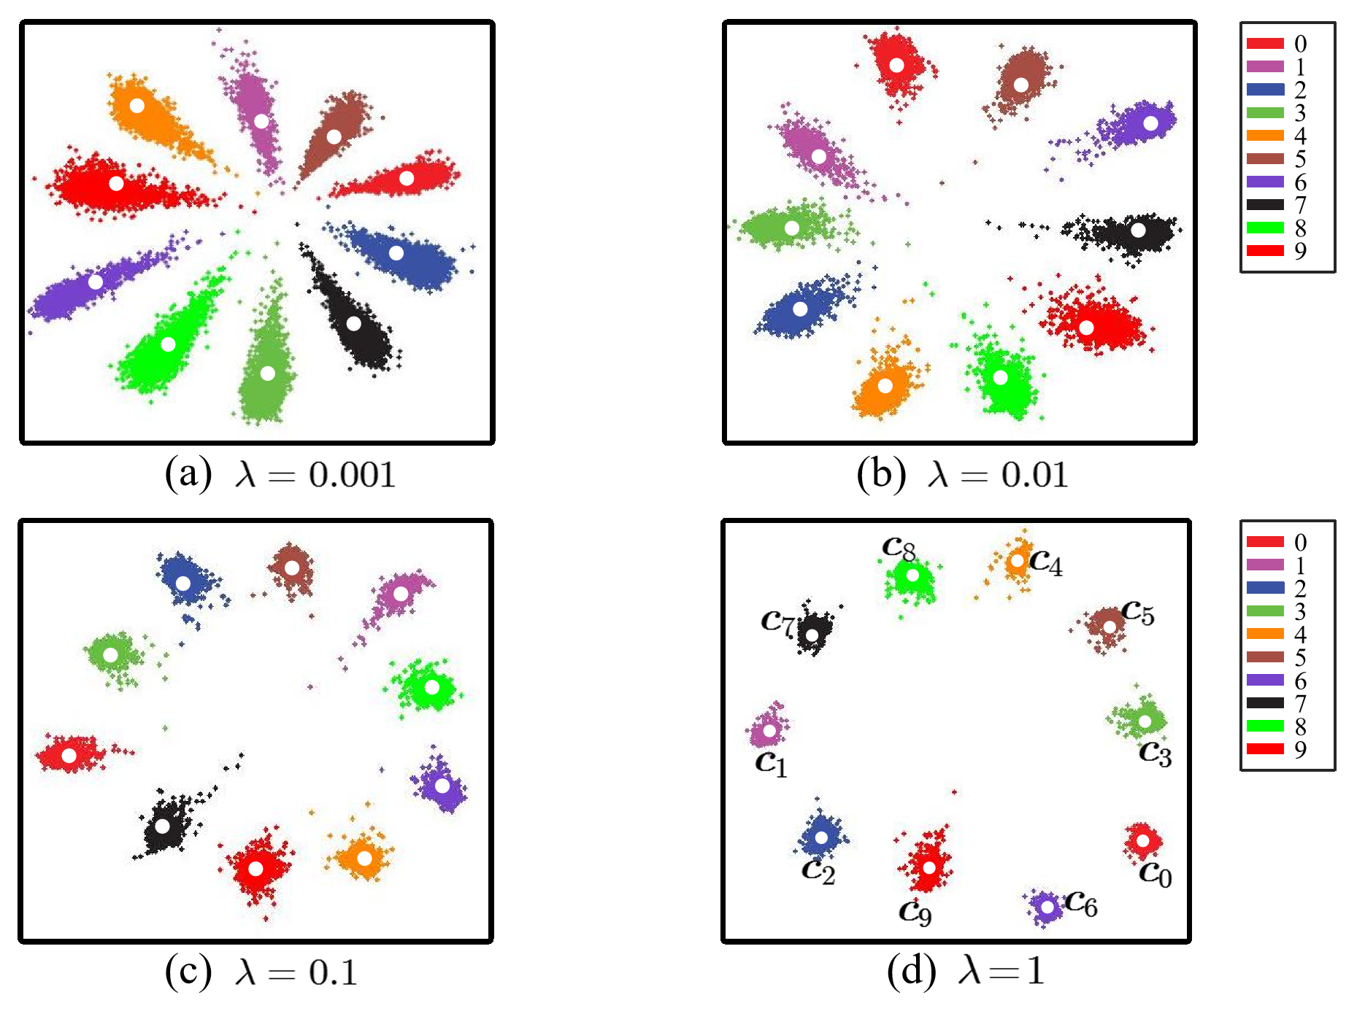
Center loss for face verification
Proposed in ECCV 2016.
Used as regularization on Softmax loss for verification tasks.
Smaller intra-class variance
→ better generalization.
Wen Y, Zhang K, Li Z, et al. A discriminative feature learning approach for deep face recognition. ECCV 2016

Slide 9
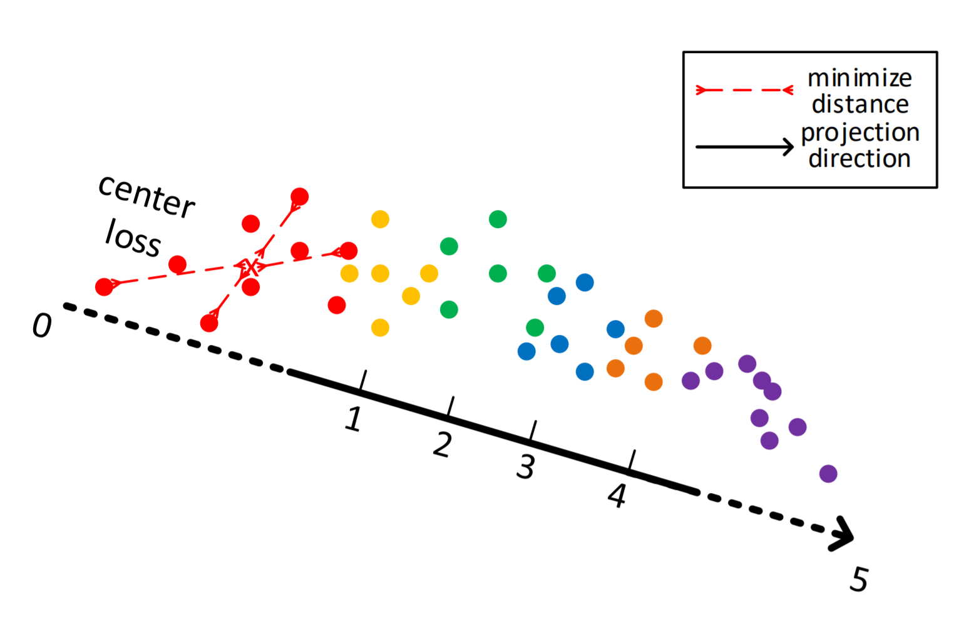
Center loss for discrete label regression
Training on small datasets usually needs stronger regularization.
Generalization is also needed by regression tasks.
Center loss is also good at regression.
Best for discrete label.

Slide 10
Other experimental details
Face images are aligned to be upright.
Less neurons on newly added fully-connected layer (less overfitting).
50% dropout is applied before the fully-connected layer (less overfitting).
Output is truncated by 5 * sigmoid function to fit the pain level 0-5.
Smooth L1 loss [1] is used instead of L2 loss (numerical stable).
Here we use t=1.
[1] Girshick R. Fast R-CNN. ICCV 2015.

Slide 11
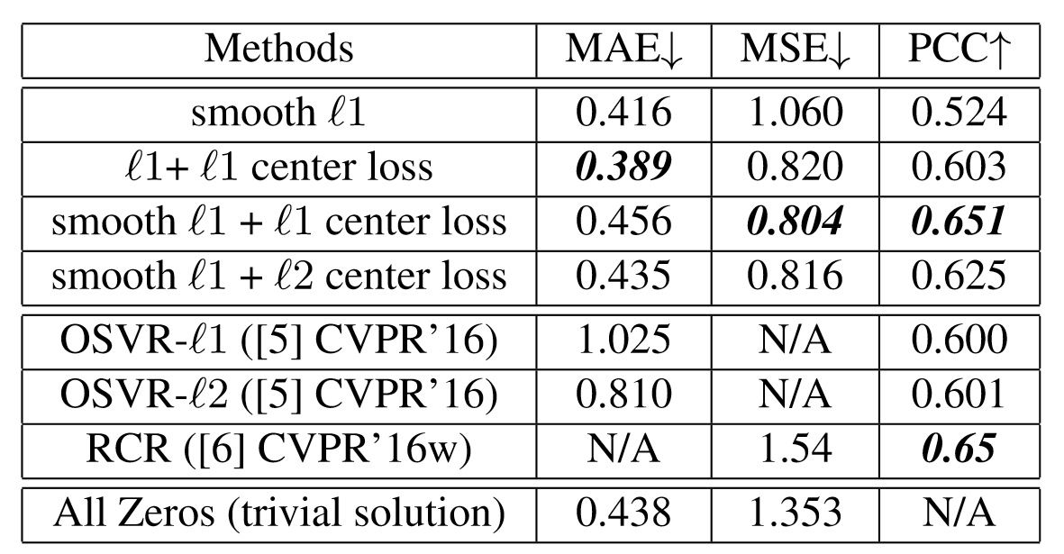
Experimental results
MAE: Mean Absolute Error.
MSE: Mean Square Error.
PCC: Pearson Correlation Coefficient.
Interesting result:
All zero prediction already surpass several state-of-the-art model!

Slide 12
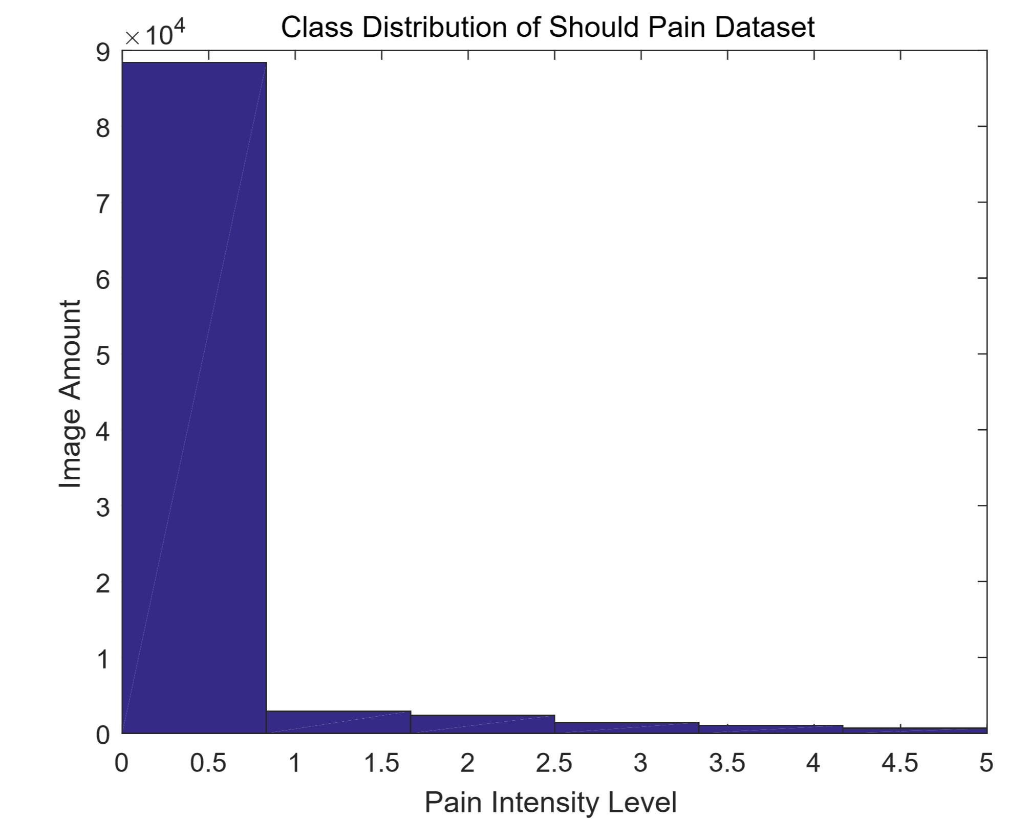
Imbalance problem
91%+ images are labeled as no pain.
Its safe for models to predict more zeros.
From MAE and MSE, we can’t distinguish if the model fits better or just predicts more zeros.

Slide 13
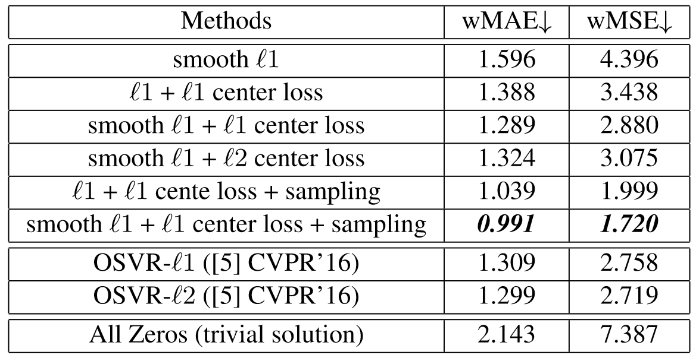
New evaluation metrics
We propose wMAE and wMSE to fairly evaluate the performance.
“w” means weighted.
MAE and MSE are weighted by the inverse frequency of each pain level.

Slide 14
Data sampling
Remove redundant images.
- Only train images when pain level changes.
Uniform sampling.
- Sample one image from each pain level in sequence.
i.e. 0 1 2 3 4 5 0 1 2 3 4 5 ……

Slide 15
Summary
Contribution:
1. Transfer from face recognition model.
2. Center loss for regression tasks.
3. New metrics to fairly evaluation the performance.
Future work:
1. Labels are expensive -> semi-supervised learning.
2. Modeling the temporal information.

Slide 16
Thank you!

